Slide 1
Cost of living project
Power bi project 1

Slide 2
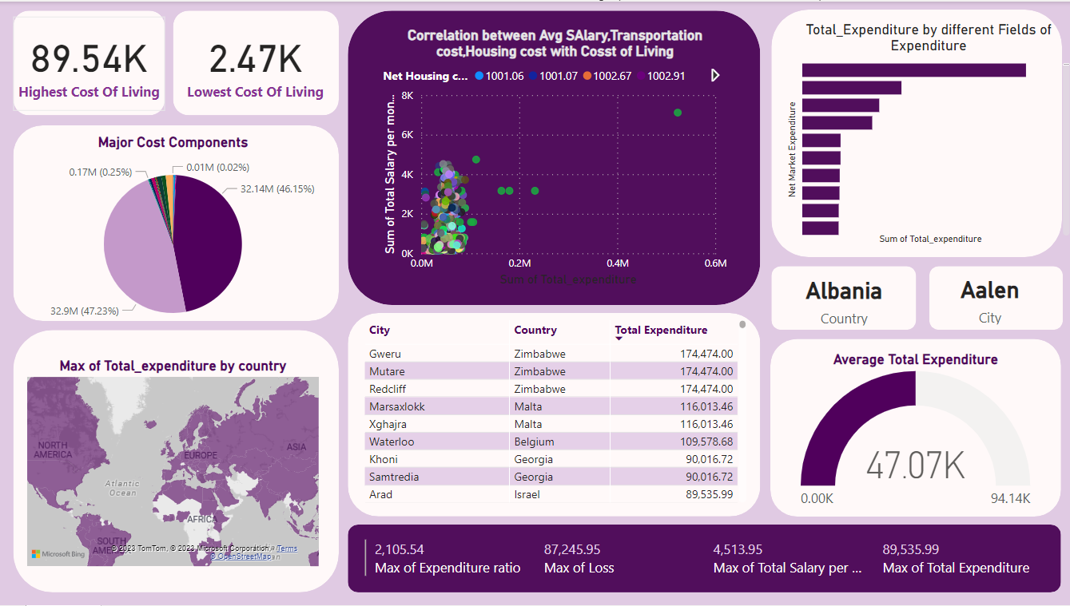

Slide 3
Importing the files
To import a CSV file into Power BI, start by opening the Power BI Desktop application. In the "Home" tab, click "Get Data," and choose "Text/CSV" as the source. Connect to your CSV file by navigating to its location and clicking "Open." Confirm the data in the preview, then click "Load" to import it into Power BI. Optionally, use the Power Query Editor for data transformations. Explore the data model in "Data" view, create visualizations in "Report" view, save the file, and share or publish for broader access.

Slide 4
Data Cleaning and Transformation of Data
In Power BI's Power Query Editor, review and clean data by removing null values filtering irrelevant data, changing data types, handling missing values and fixing outliers
. Add custom columns for additional insights. Remove unnecessary columns and sort or filter data as needed. Regularly preview changes, ensuring the data is accurate.
Close the editor, apply changes, and continue with data analysis in Power BI. Save the Power BI file (.pbix) after completing the cleaning process.

Slide 5
Visiualization
In Power BI's "Report" view, drag and drop fields onto the canvas to create visualizations such as charts and tables. Customize visuals by adjusting formatting and colors. Establish relationships between tables if working with multiple datasets. Enhance interactivity with slicers and filters for dynamic data exploration. Apply themes and styles to improve the overall appearance.
Save the Power BI file (.pbix) and consider sharing or publishing reports to the Power BI service for wider accessibility. This iterative process ensures effective data visualization and meaningful insights for decision-making.

Slide 6
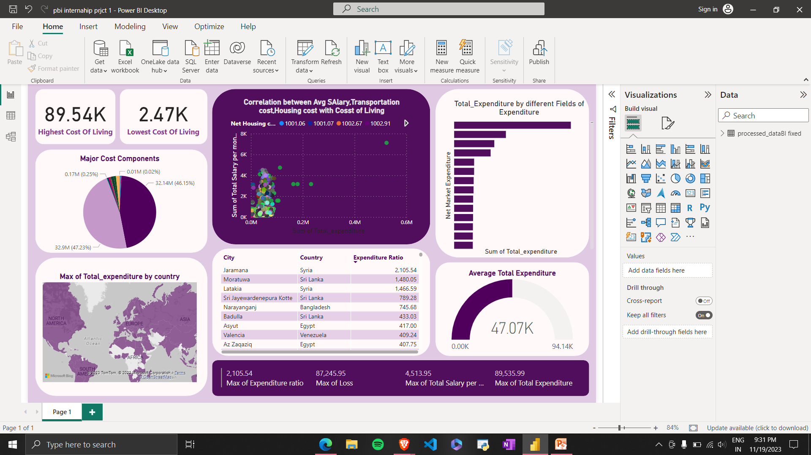
Examples
This Power BI scatter plot visually conveys correlations among essential variables—net transportation expenditure, housing expenditure, marketing expenditure, basics, etc.—with a specific focus on their associations with total salary and the cost of living. Positioned in the "Report" view, the plot utilizes color or size variations for added granularity. Cross-visual relationships are established for seamless integration with visuals representing total salary and cost of living. This professionally presented visualization is designed for clarity and insights, supporting informed decision-making in a concise format.

Slide 7
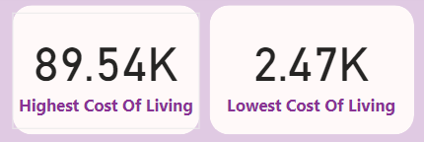
Insights
What are the cities and countries with the highest and lowest costs of living?
So the country with highest cost of living are Zimbabwe Gweru and Mutare.

Slide 8
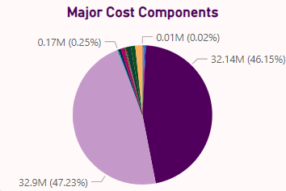
What are the major cost components contributing to the overall cost of living in a region?
Volkswagen Golf 1.4 90 KW Trendline and Toyota Corolla Sedan 1.6l 97kW Comfort from Transportation Expenditure are Major cost components.

Slide 9
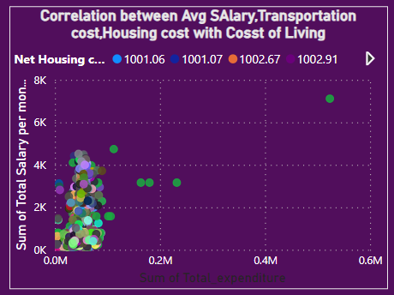
How do factors like average salary, housing costs, and transportation expenses correlate with the cost of living?

Slide 10
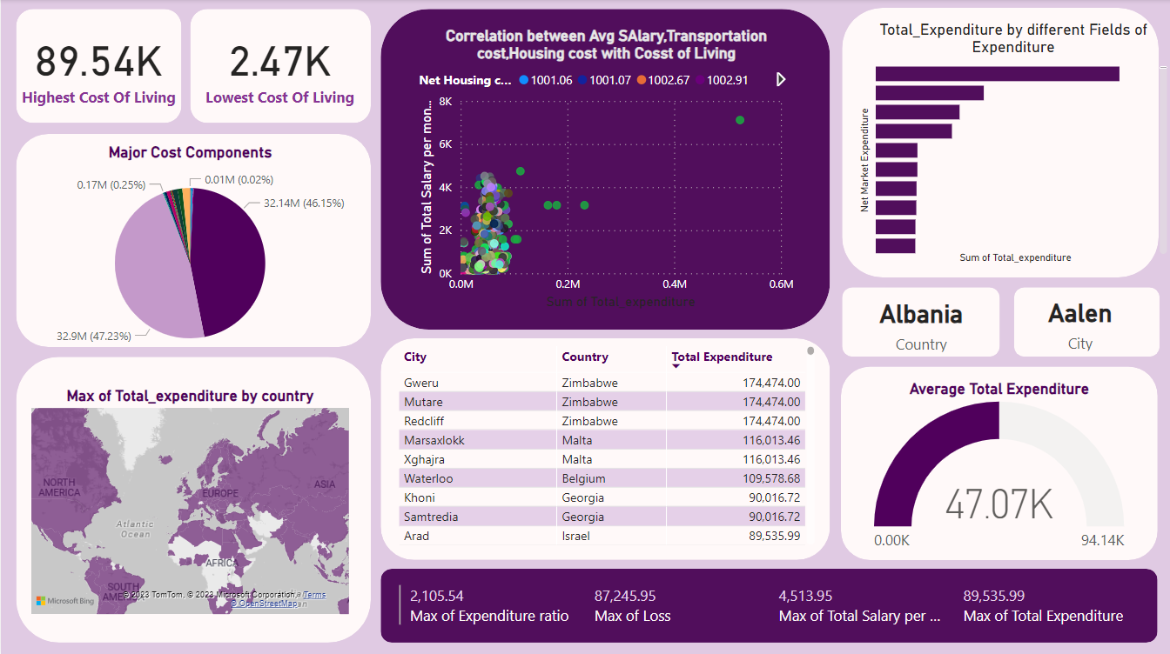
Are there any trends or patterns in the data that can help individuals and organizations make strategic decisions?
Yes, there are various trends and can help individual and organizations to make strategic decisions.

